Slide 1
Divisi : XI – Bisnis TIK

Slide 2
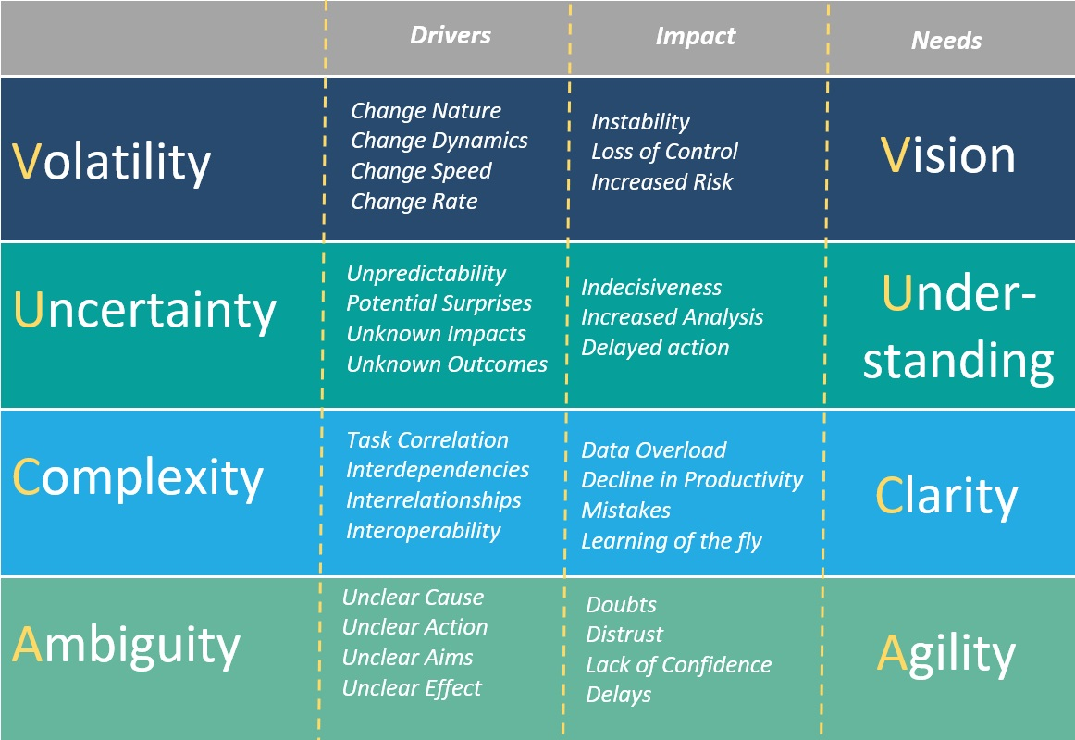
Current Business - What’s to learn?
Facing VUCA (Volatility, Uncertainty, Complexity and Ambiguity condition, student learn from the process activity on problem solution fit & product market fit.

Slide 3
The different concept learning approach on business today
Business Plan
Pitch Deck
Detailed evaluation on Business
Product innovation base approach
Make plan and forecasting
Start-Up based lean Methodology
Core (Business Innovation} process:
Eliminating waste – (speed)
Creating value for customers
Improving continuously
Respecting people
Activity based traction evaluation

Slide 4
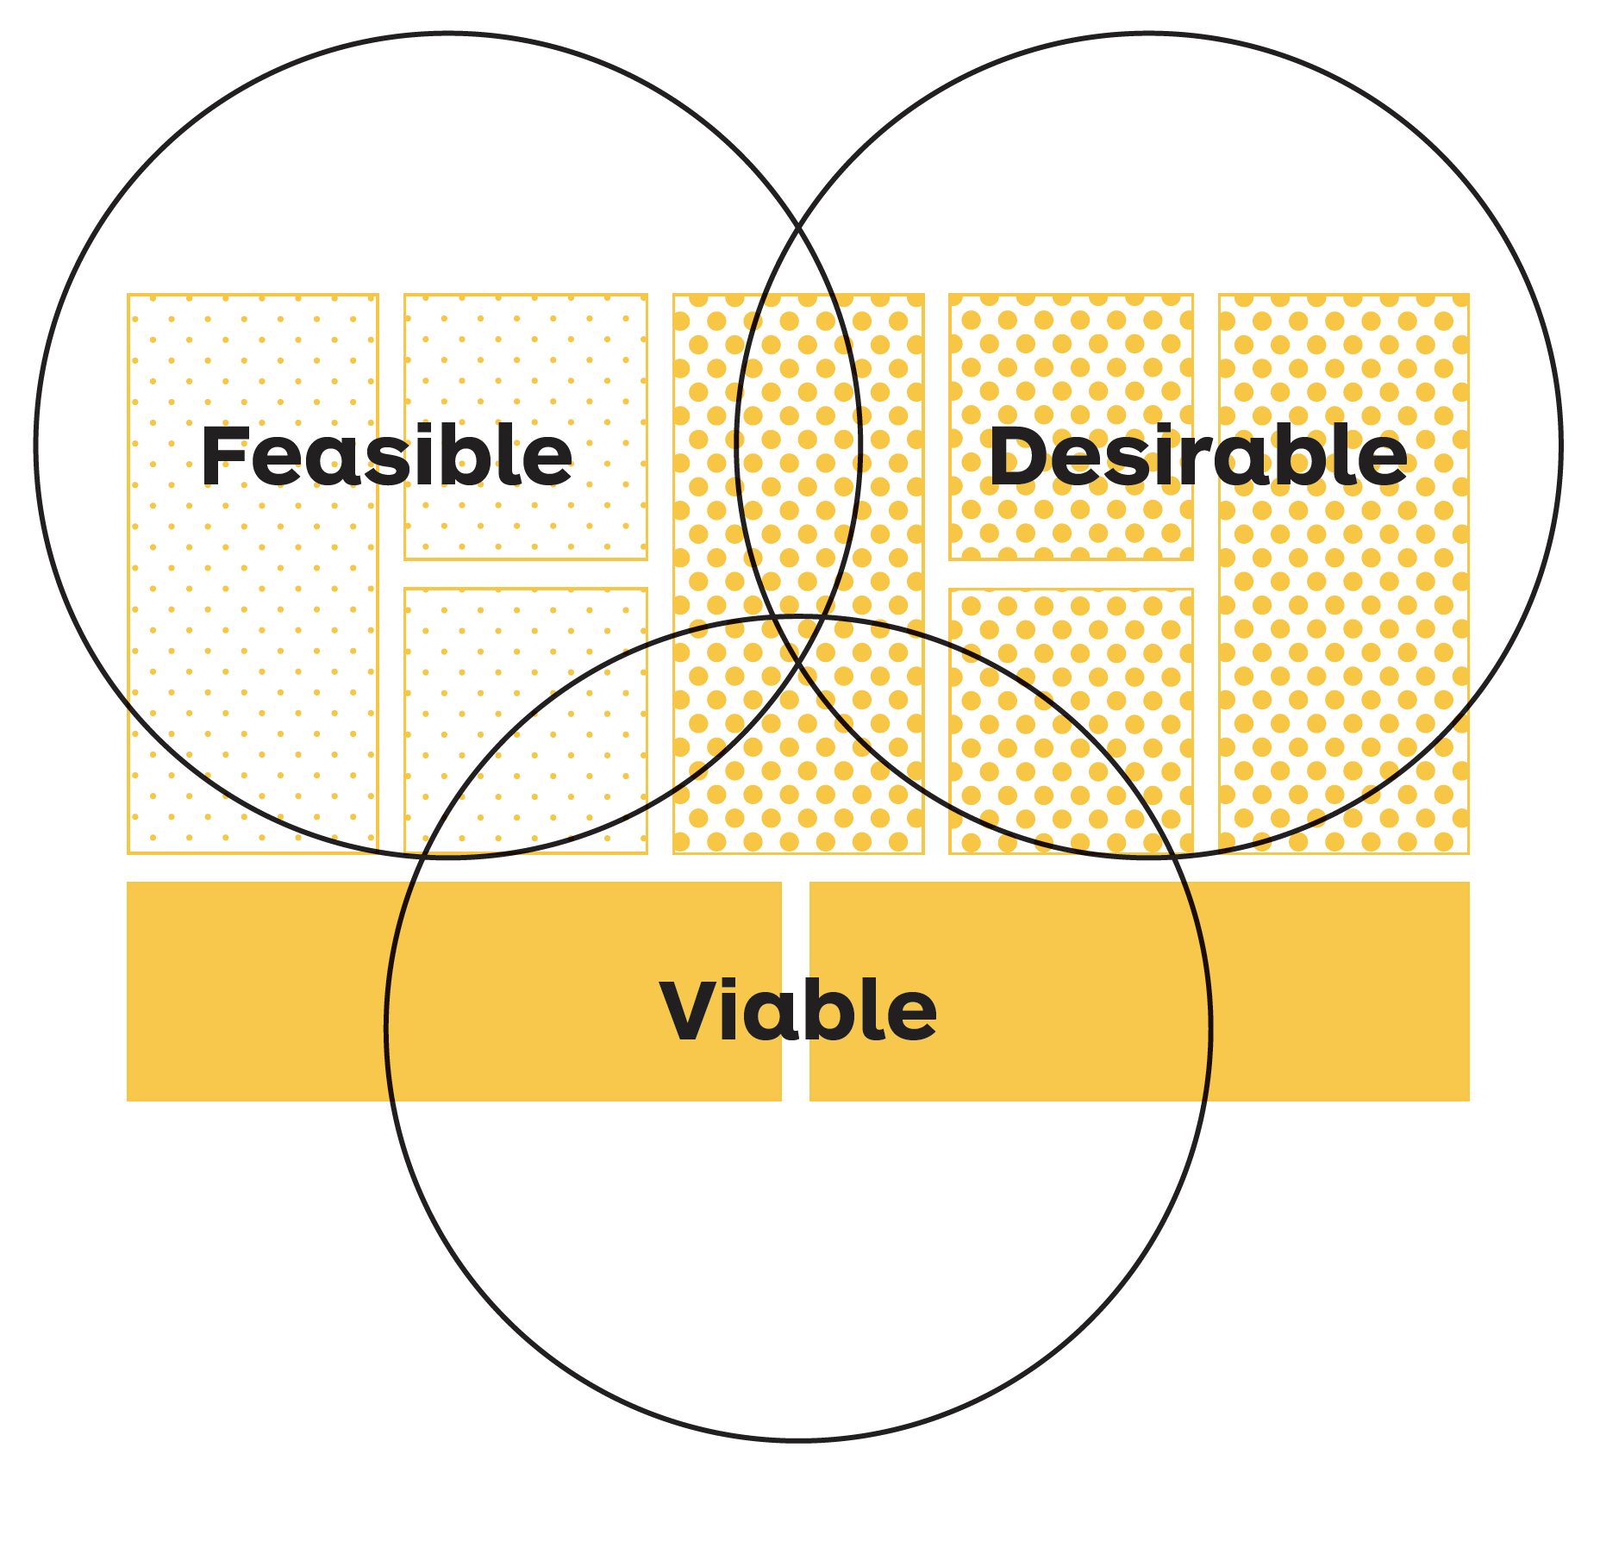
Types of Hypotheses on the Business Model Canvas

Slide 5
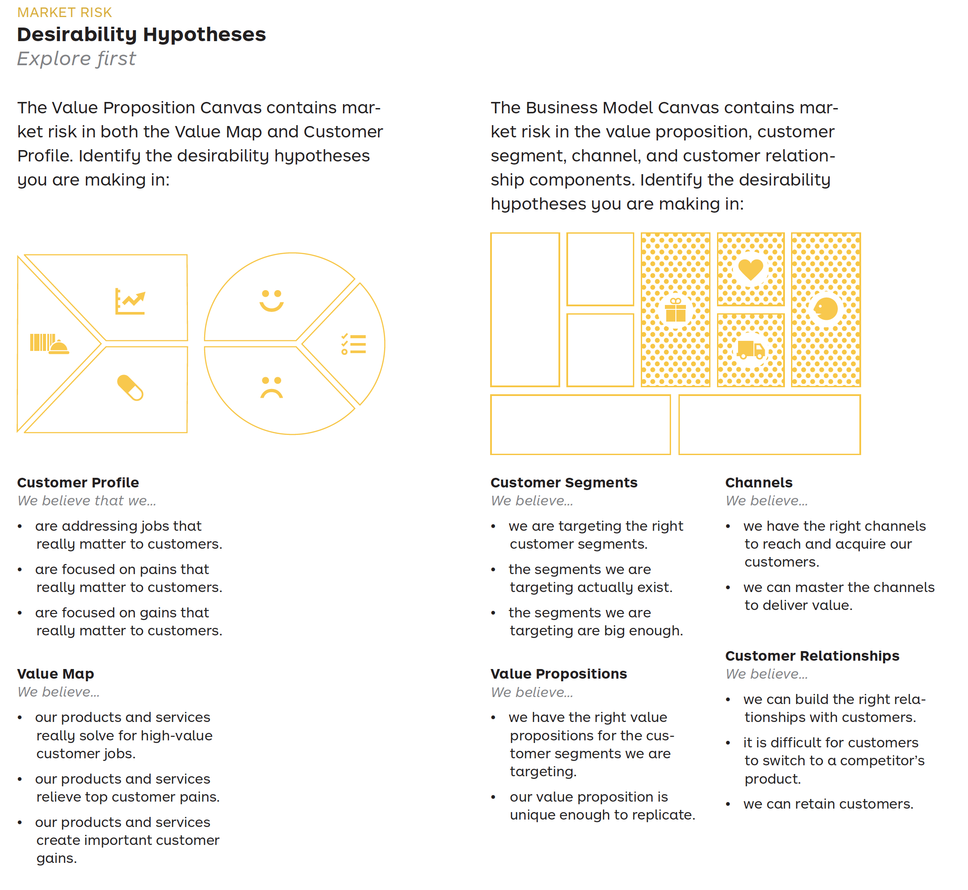

Slide 6
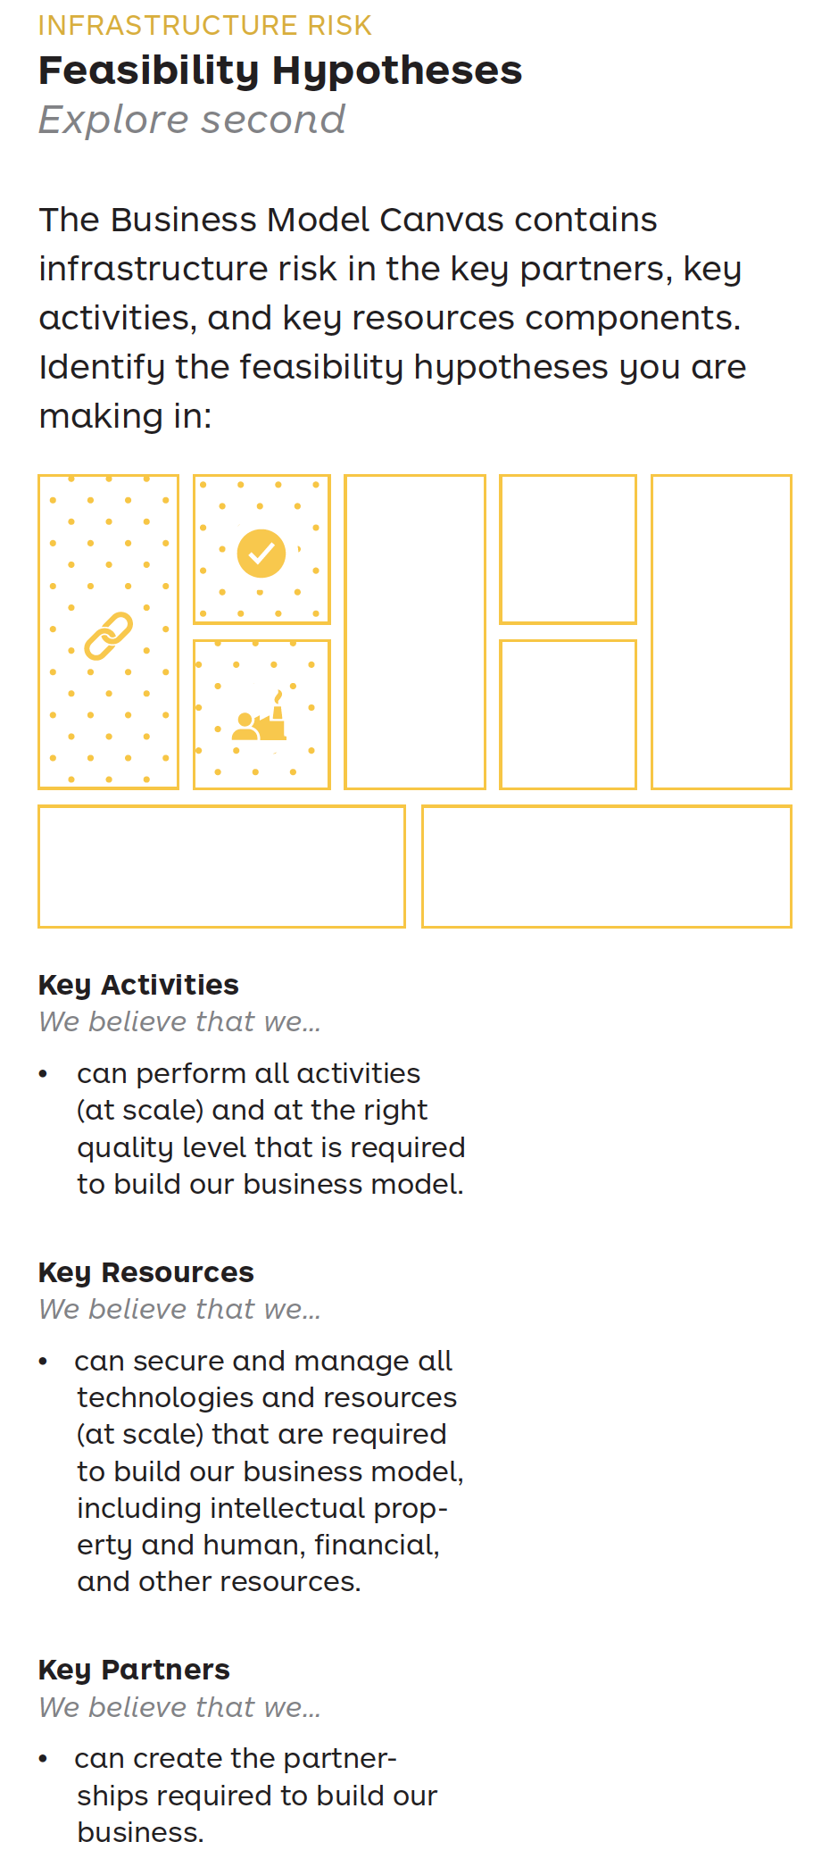
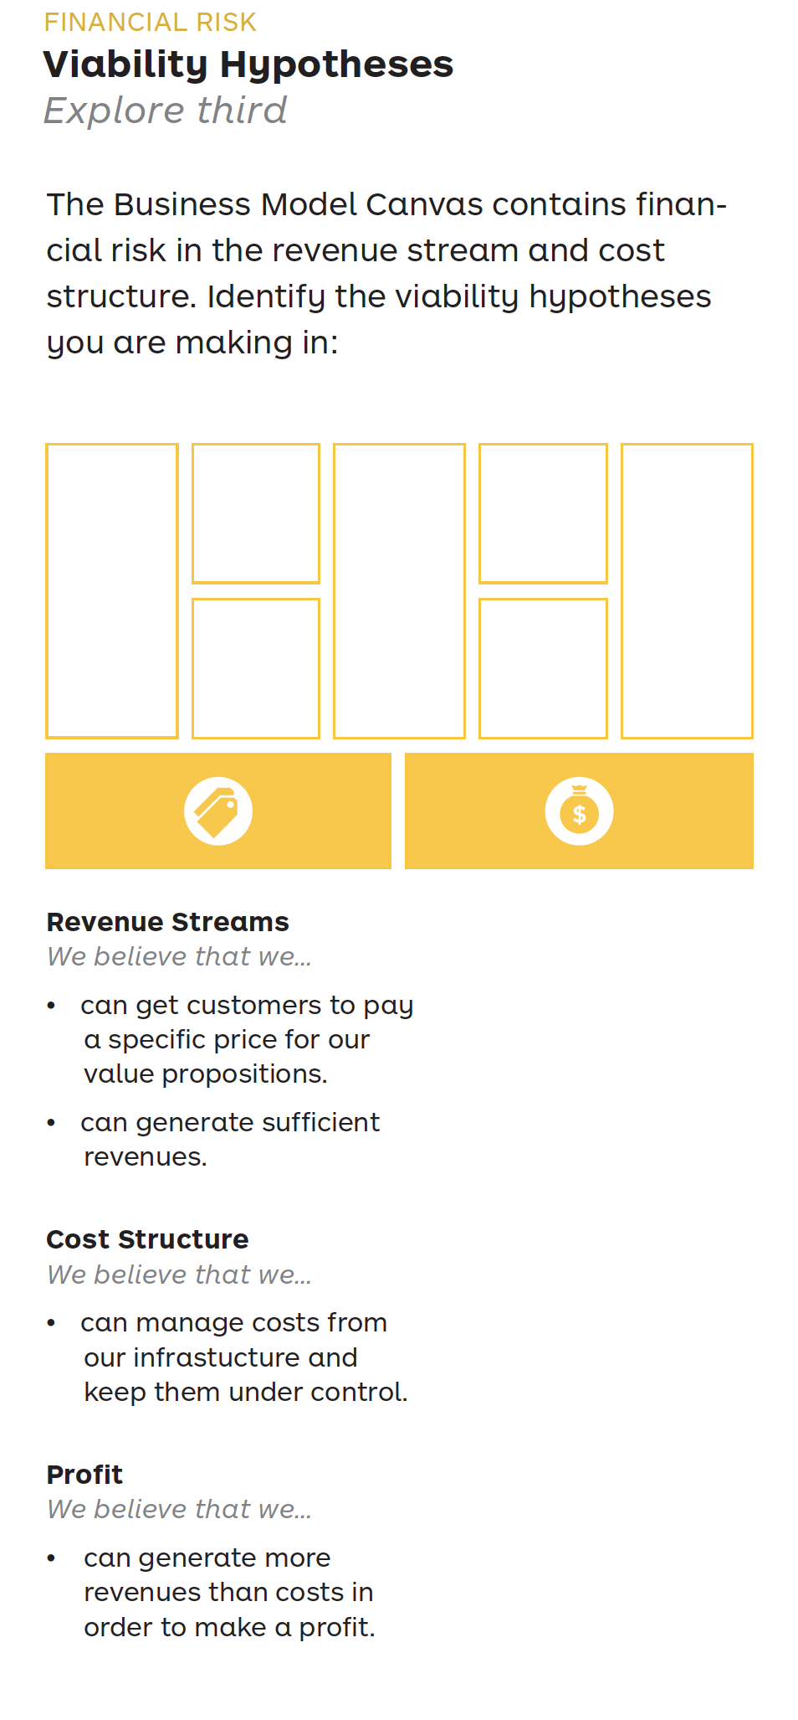

Slide 7
Pendaftaran & Unggah Dokumen : 1 April – 17 Juni 2024
Penyisihan Daring : 18 Juni – 22 Juni 2024
Pemgumuman Daftar Finalis : 26 Juli 2024
Pendaftaran Ulang Kepesertaan ke Babak Final : 18 Agustus – 2 Sept 2024
Babak Final dan Puncak Acara : 9 – 13 September 2024

Slide 8
Terima kasih
Selamat berbisnis.
Jury Bisnis TIK 2024
Karyana Hutomo

